Slide 1
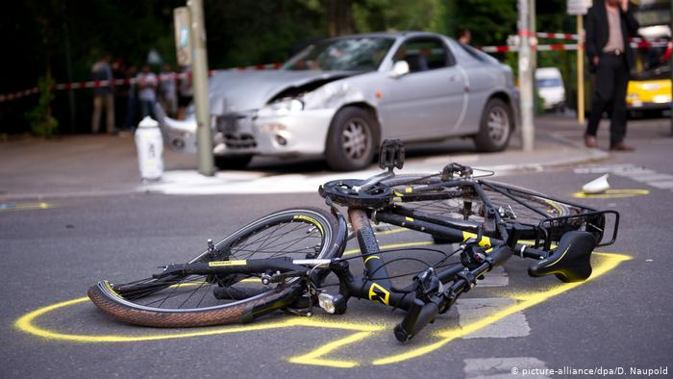
Saving lives
Analysis of UK Road Accidents over last 4 years
By Brian Dorricott, brian@briandorricott.com, +61 (0)434 799 829

Slide 2
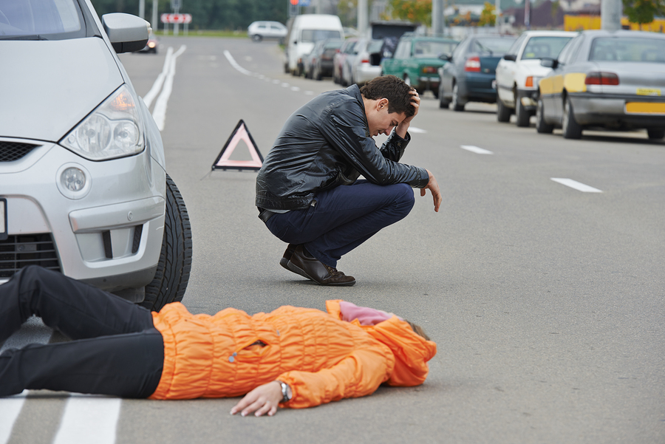
Just think of the cost of an accident
EMOTIONAL
Who won’t return home?
SOCIAL
Impact on friends & work colleagues
FINANCIAL
Fatalities £2,200,000³
Serious Injury £250,000³
Slight £27,000³
What can we do to reduce it?

Slide 3
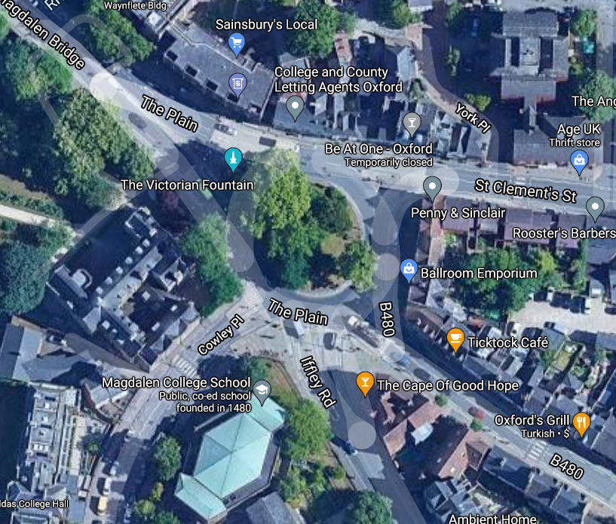
Analysing four years of accident data, we’ve identified 6,400 accident black spots⁴ costing authorities over £500M per year (all accidents cost over £16B). For example, one junction in Oxford has 15 accidents per year costing £1.1M. By concentrating our limited resources on these areas, we can save money, reduce emotional stress and minimise the social impact of accidents.
Our hypothesis: There are concentrations of vehicle accidents: “Black Spots”. If we know where they are and the specific accident conditions, we can make changes to save lives, property and money for minimal cost.

Slide 4
How did we find the Accident Black Spots?
Downloaded and examined UK road accident safety data
500,000 accidents over 4 years
Identified a hypothesis
What would make an impact?
Analysed the data
Python cluster identification
Visualised the results
PowerBI interactive display using accident data & cluster information
Gained & recorded insights
Yes, there were feedback loops!

Slide 5
Challenges
Standard clustering techniques
Require knowledge of number of clusters expected
Affinity Propagation
Agglomerative Clustering
BIRCH
K-Means
Spectral Clustering
Gaussian Mixture Model
Require over 100GB of memory
DBSCAN / OPTICS
Mean Shift
None would solve our problem

Slide 6
Our solution
Interesting features…
Large number of samples (>500,000)
Accident hotspots are distal (>100m)
Data set has 10m accuracy
50m distance considered “close” in data set
Python Code
Load data
For each accident, find any others within 50m
If any accident already in cluster,
add ours to this cluster
Otherwise create new cluster
Record which cluster accident is in
Save cluster list & accident list
Execution time
Non-linear:
30m for 250,000 accidents (2 years)
2h30m for 500,000 accidents (4 years)

Slide 7
Results
Interactive report
See PowerBI interactive visual
Three examples follow
Worst black spot
Lighting affects accidents
Urban v. Rural accidents

Slide 8
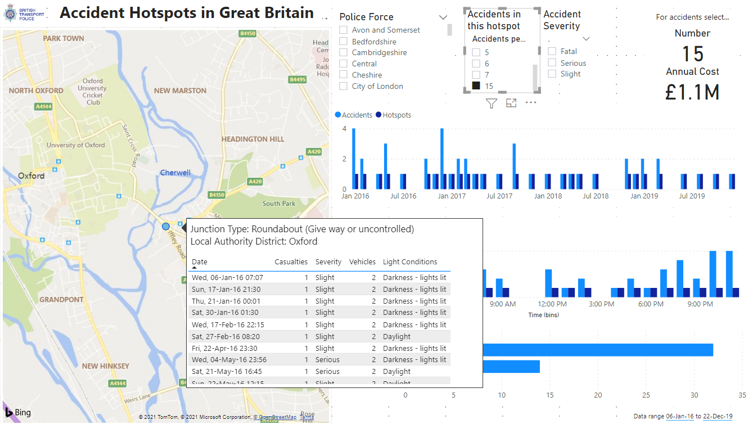
Most accident prone location in UK is
in Oxford, with 15 accidents per year
Note the irony
“The Cape of Good Hope”

Slide 9
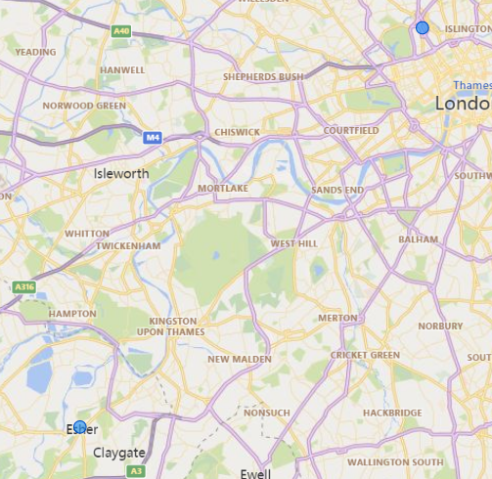
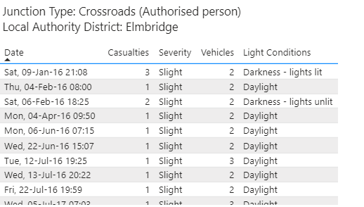
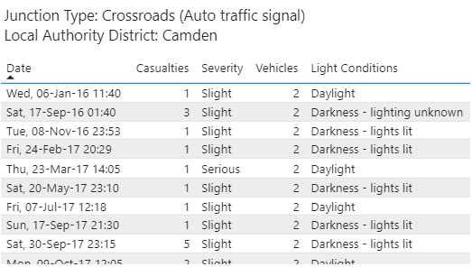
Environmental effects
At 7 accidents per year, two locations:
one daylight hours, other in darkness

Slide 10
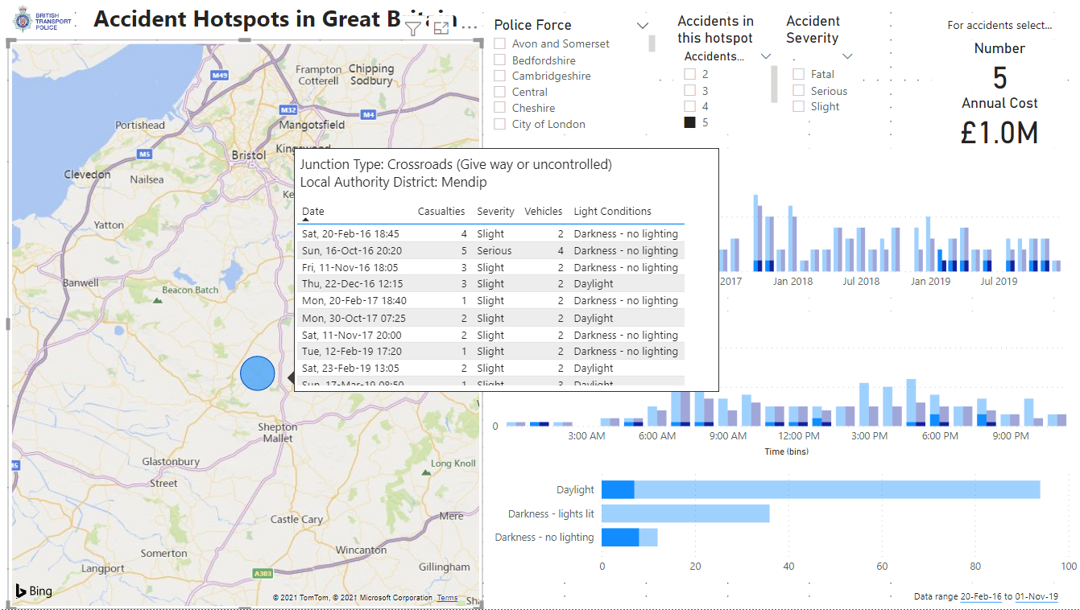
Not all are in urban areas

Slide 11
Outcomes
By identifying hotspots, we can:
Save lives
Save property
Save near-misses (which are not recorded)

Slide 12
Improvements
Utilise additional information
Vehicle and casualty details
Add cost as graded colour to map
Increasing number of years of data
2016-2019 available, what about 2020?
Feature selection at Blackspots
E.g. increase lighting at {these locations} to reduce accidents

Slide 13
References
Picture credit: https://static.dw.com/image/48170995_303.jpg
Picture credit: https://www.levininjuryfirm.com/wp-content/uploads/2014/09/pedestrian-accident.jpg
Road accident costs by severity Great Britain 2019 | Statista - https://www.statista.com/statistics/322862/average-cost-of-road-accidents-and-casualties-in-great-britain-uk/
“Blackspot” defined as an average of more than 2 accidents per year over 4 years.

